Slide 1
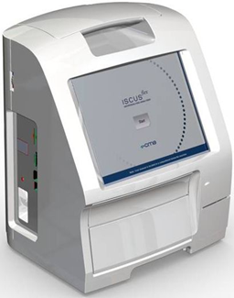
D8755-17 ISCUS^{flex} software Rev M (ver 3.0.11.53) presentation
ISCUS^{flex} New Software Version August 2026
Rev M Version 3.0.11.53

Slide 2
Overview
Operating system – Windows 11
Controlling computer – Surface Pro 11
New main board
Software ported and updated from Win CE5
Built in debug
Built in ICUpilot and IscusCollect
Fast responses in GUI
AnyDesk for remote support

Slide 3
Selected defect fixes
(TT #394 – TT #405)
TT #394 QCData.txt has erroneous List separator after Date-Time
TT #395 Reagent cassette status is not properly updated after restart
TT #396 Please wait text not translated when opening reagent cassette
TT #397 Confusing sample batch setup
TT #398 Number of decimals shall be selectable

Slide 4
Selected defect fixes
(TT #394 – TT #405)
TT #399 Application shall be locked to use the SIP (on screen keyboard)
TT #400 General layout assessment
TT #401 Exceptions in Settings/Scaling when selecting <All> catheters
TT #402 When selecting Elevated Control an Exception occurs
TT #403 Editing a single vial in a batch sequence is not possible

Slide 5
Selected defect fixes
(TT #394 – TT #405)
TT #404 Clicking on microvials in the status bar shall not lock it
TT #405 Clicking on the External Device icon shall give options to connect or disconnect network share

Slide 6
Service codes
No new service codes
D6558-23 P192 ISCUSflex Service codes (Rev M 3.0.11.44 and later)

