Slide 1
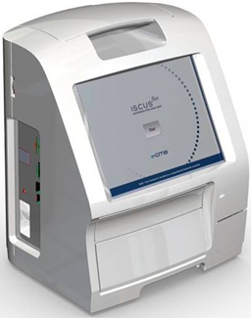
D8755-16 ISCUS^{flex} software Rev M (ver 3.0.11.44) presentation
ISCUS^{flex} New Software Version March 2026
Rev M Version 3.0.11.44

Slide 2
Overview
New operating system – Windows 11
New controlling computer – Surface Pro 11
New main board
Software ported from Win CE5
Built in debug
Built in ICUpilot and IscusCollect
Fast responses in GUI
AnyDesk for remote support

Slide 3
Selected defect fixes (TT #340 – TT #393)
TT #340 New Service Code ICUPILOT to start or show ICUpilot
TT #344 PowerMonitor. Monitors power
TT #347 Several service codes added (PACKLOGS)
TT #348 CPL files may be run (Control Panel files)
TT #349 Brightness Control. Software control of Screen brightness
TT #365 Factory reset function requested. Service code FACTORY RESET

Slide 4
Selected defect fixes (TT #340 – TT #393)
TT #377 Messages dialog should copy text to ClipBoard
TT #380 Service log entries shall be created when closing the application
TT #383 Loopback network shall be possible
TT #384 Using localhost in Settings/Data shall be possible
TT #386 New service codes DEBUG, DEBUG STOP and DEBUG CLEAN

Slide 5
Selected defect fixes (TT #340 – TT #393)
TT #387 New service code DEBUG SCANNER
TT #388 New service code ISCUSCOLLECT
TT #389 A simple method to find old data in graphs
TT #390 Printout for A4/Letter format with CSV option
TT #391 Printout dialog should have printer icon for printer selection access

Slide 6
Service codes
SHOW PACKLOGS - Show packlogs folder in explorer
PACKLOGS - Packs log files for trouble shooting
PACKLOGS CLEAR - Clears the packlogs files, only the latest logs are packed
CLOSE - Closes the running application (ServiceGUI/UserGUI)
RESTART - Restarts the application

Slide 7
Service codes
ICUpilot – To start ICUpilot
FACTORY RESET – To reset machine parameters
DEBUG – To start OnlineLogger
DEBUG STOP – To stop OnlineLogger
DEBUG CLEAN – To delete old logs
DEBUG SCANNER – To start measurement curves exploration

Slide 8
ISCUSCOLLECT – To start IscusCollect for saving data in ICUpilot and relaying data to ER/PDMS

Slide 9
Service codes
D6558-23 P192 ISCUSflex Service codes (Rev M 3.0.11.44 and later)

