Slide 1
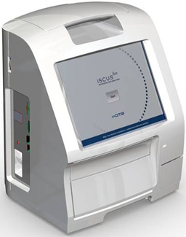
D8755-15 ISCUS^{flex} software Rev L (ver 2.1.0.494) presentation
ISCUS^{flex} New Software Version March 2022
Rev L Version 2.1.0.494

Slide 2
Overview
Lactate calibrator response fix
Difficulties to measure Glucose blank. Fixed, notice in service log.
Default sample and reagent volumes according to service code SAMPLEVOL OPTION

Slide 3
Defect fixes (TT #335 – TT #338)
TT #335 Lactate calibrator response too high. Automatic update at startup. Implemented also as an ISCUS tools fix.
TT #336 Difficult to measure Glucose blank. Fixed, notice in service log. Handles initially noisy reagents.
TT #337 Default sample and reagent volumes set to SAMPLEVOL OPTION
TT #338 Faulty sample volumes for preclinical Glucose. Corrected

Slide 4
Service codes
D6558-17 P192 ISCUSflex Service codes (Rev L 485 and later)

